Slide 1
Simulation of Inverted Pendulum with Active Suspension
Daniel Sotingco
December 6, 2011
2.152 Nonlinear Controls Final Project

Slide 2
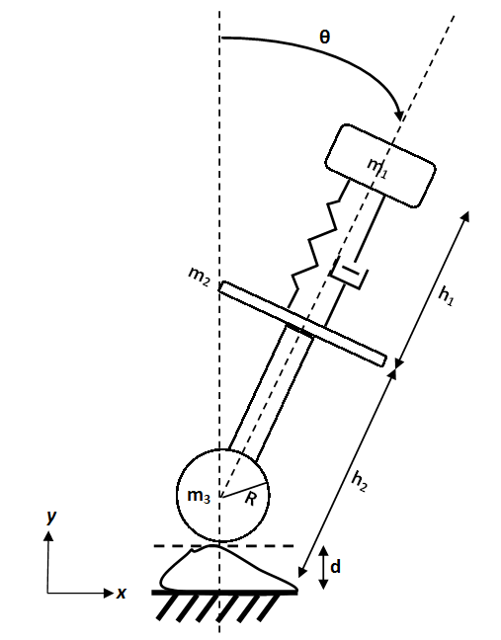
System Model

Slide 3
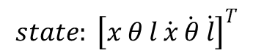
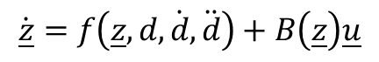
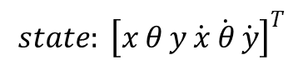
Equations of Motion
$$state: {\left[x θ l \dot{x} \dot{θ} \dot{l}\right]}^{T}$$
$$state: {\left[x θ y \dot{x} \dot{θ} \dot{y}\right]}^{T}$$
$$\dot{\underline{z}}=f\left(\underline{z},d,\dot{d},\ddot{d}\right)+B\left(\underline{z}\right)\underline{u}$$

Slide 4
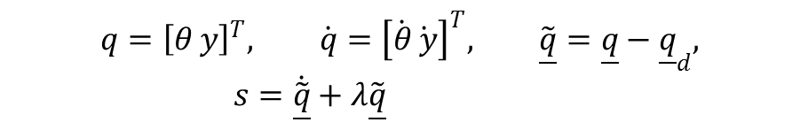
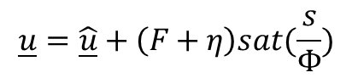
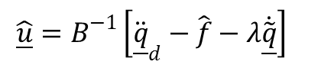
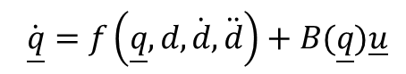
Controlling Pendulum Angle & Ride Height: Sliding Control
$$q={\left[θ y\right]}^{T}, \dot{q}={\left[\dot{θ}\dot{ y}\right]}^{T}, \tilde{\underline{q}}=\underline{q}−{\underline{q}}_{d}, s=\dot{\tilde{\underline{q}}}+λ\tilde{\underline{q}}$$
$$\dot{\underline{q}}=f\left(\underline{q},d,\dot{d},\ddot{d}\right)+B(\underline{q})\underline{u}$$
$$\hat{\underline{u}}=B^{−1}\left[{\ddot{\underline{q}}}_{d}−\hat{f}−λ\dot{\tilde{\underline{q}}}\right]$$
$$\underline{u}=\hat{\underline{u}}+\left(F+η\right)sat(\frac{s}{Φ})$$

Slide 5
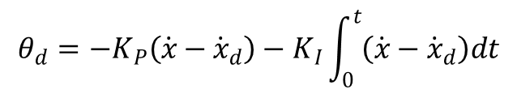
Controlling Pendulum Velocity
$$θ_{d}={−K}_{P}\left(\dot{x}−{\dot{x}}_{d}\right)−K_{I}\int_{0}^{t}{\left(\dot{x}−{\dot{x}}_{d}\right)dt}$$

Slide 6
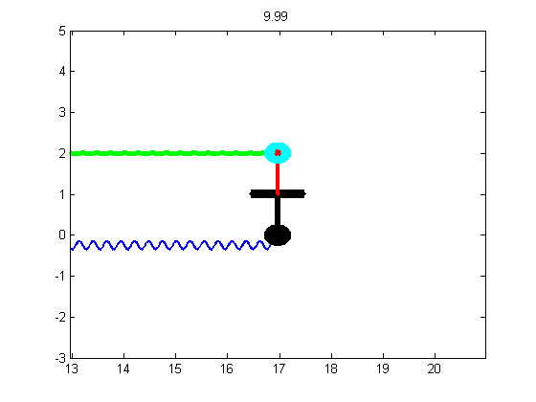
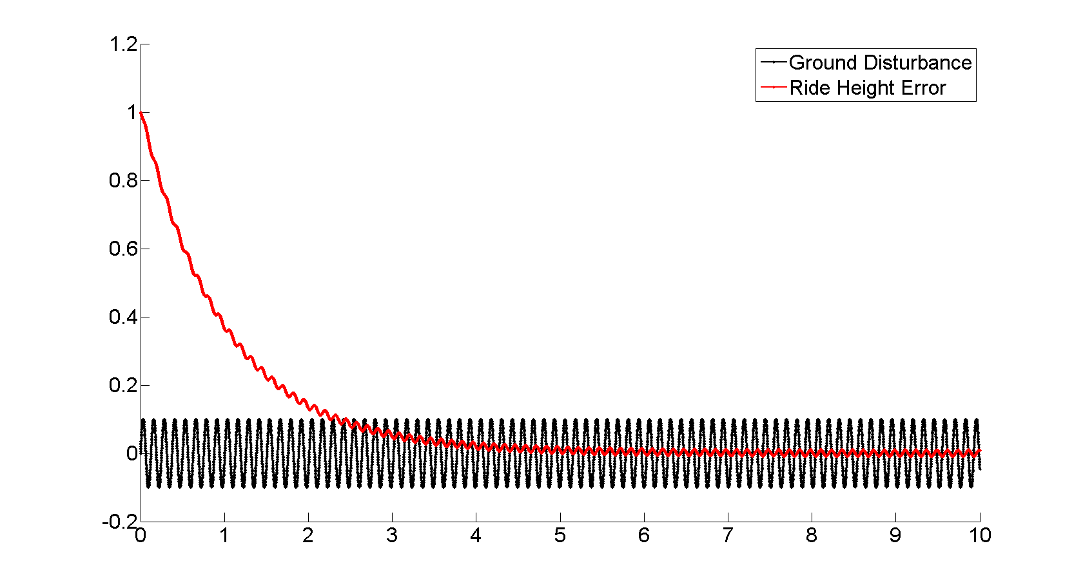
Results

Slide 7
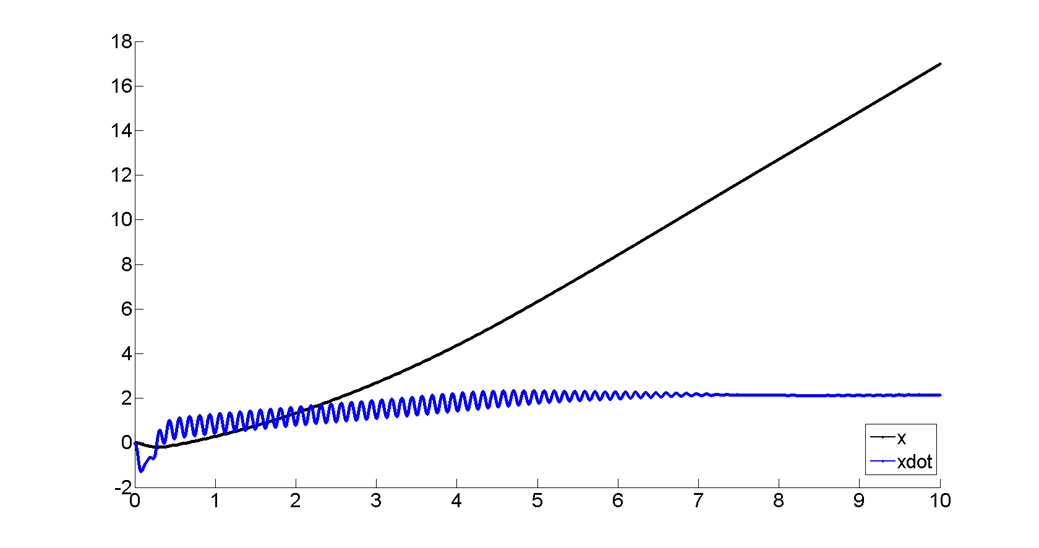
Results

Slide 8
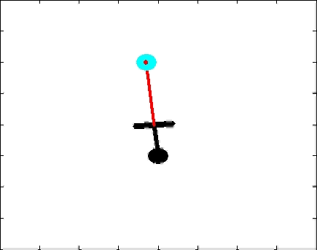
Animation

